Slide 1
Chapter 2 Basic Structures: Sets, Functions, Sequences, Sums, and Matrices
Section 2.2 :Set Operations

Slide 2
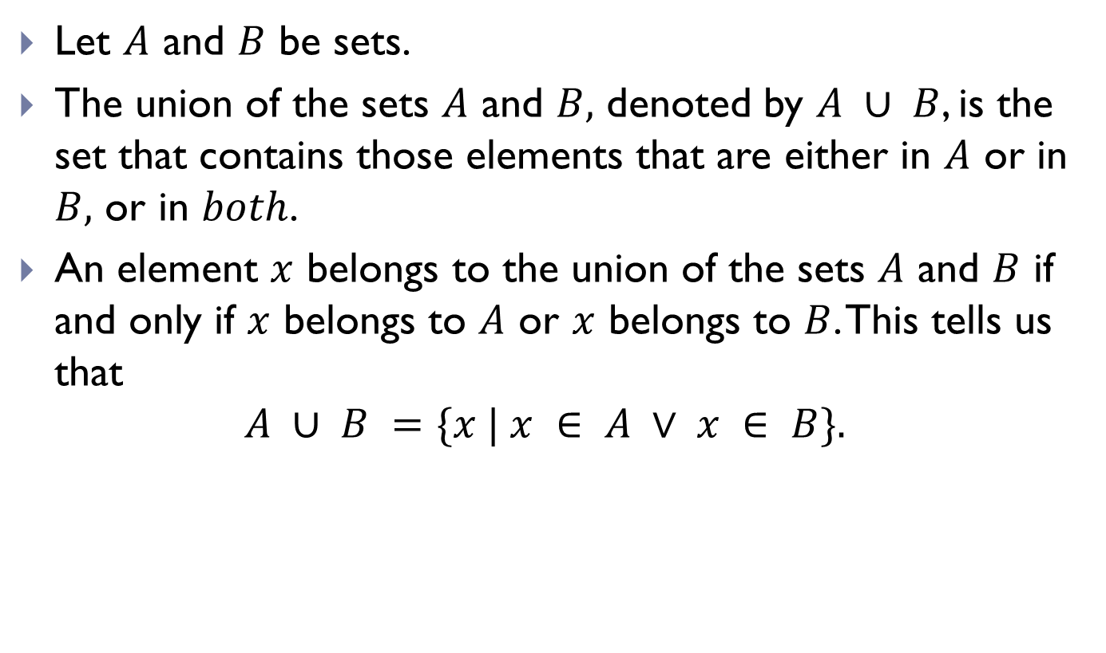
Union of Sets
Let $A$ and $B$ be sets.
The union of the sets $A$ and $B,$ denoted by $A ∪ B$, is the set that contains those elements that are either in $A$ or in $B,$ or in $both$.
An element $x$ belongs to the union of the sets $A$ and $B$ if and only if $x$ belongs to $A$ or $x$ belongs to $B$. This tells us that
$$A ∪ B =\{x | x ∈ A ∨ x ∈ B\}.$$

Slide 3
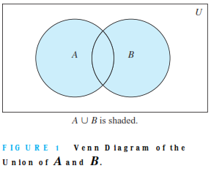
Union of Sets(Contd.)

Slide 4
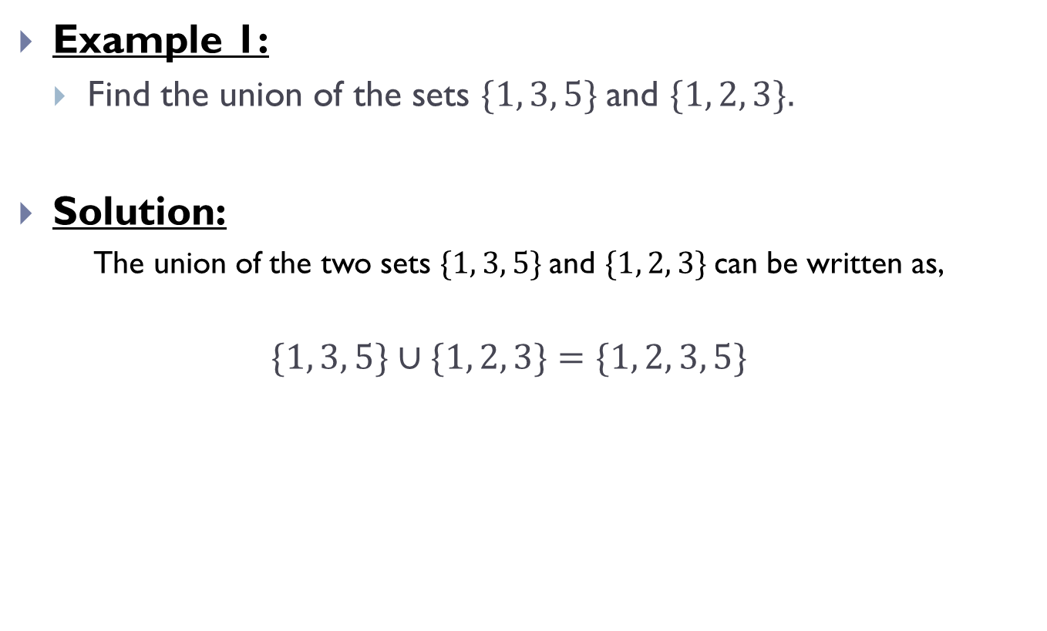
Union of Sets(Contd.)
Example 1:
Find the union of the sets $\{1, 3, 5\}$and $\{1, 2, 3\}.$
Solution:
The union of the two sets $\{1, 3, 5\}$and $\{1, 2, 3\}$can be written as,
$$\{1, 3, 5\}∪\{1, 2, 3\}=\{1, 2, 3, 5\}$$

Slide 5
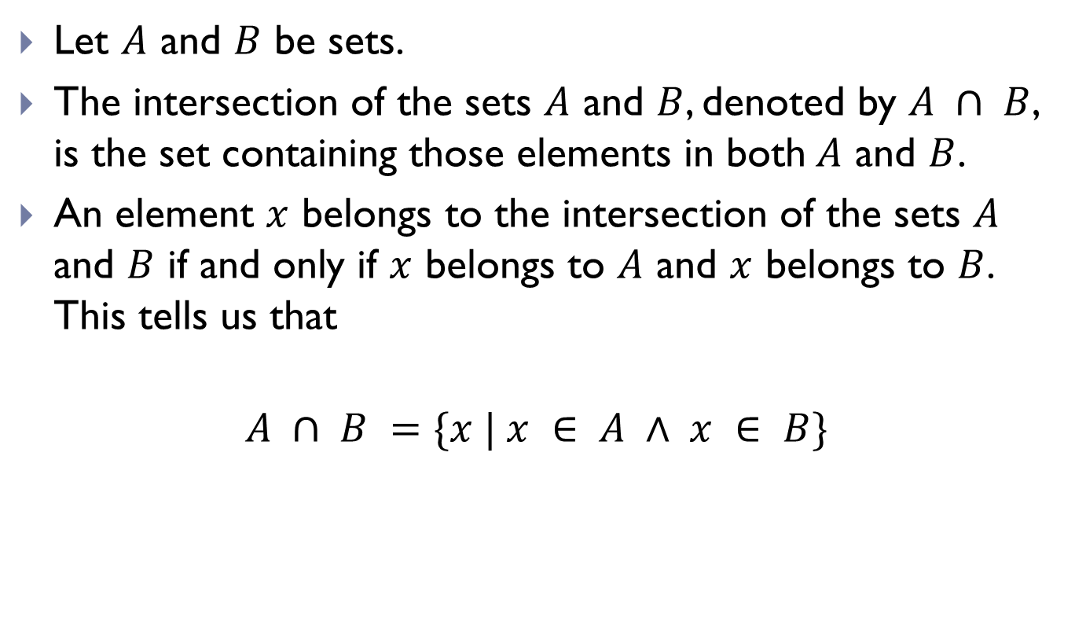
Intersection of Sets
Let $A$ and $B$ be sets.
The intersection of the sets $A$ and $B$, denoted by $A ∩ B$, is the set containing those elements in both$A$ and $B$.
An element $x$ belongs to the intersection of the sets $A$ and $B$ if and only if $x$ belongs to $A$ and $x$ belongs to $B$. This tells us that

Slide 6
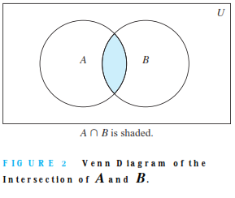
Intersection of Sets(Contd.)

Slide 7
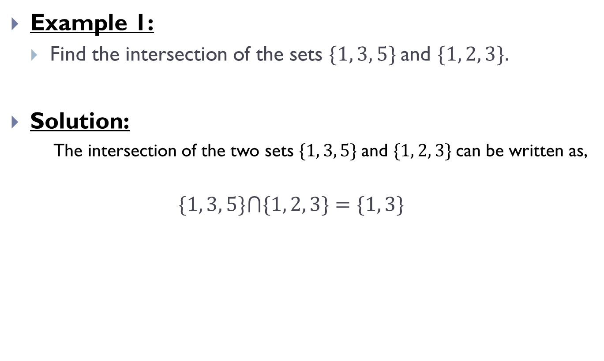
Intersection of Sets(Contd.)
Example 1:
Find the intersection of the sets $\{1, 3, 5\}$and $\{1, 2, 3\}.$
Solution:
The intersection of the two sets $\{1, 3, 5\}$and $\{1, 2, 3\}$can be written as,
$$\{1, 3, 5\}⋂\{1, 2, 3\}=\{1, 3\}$$

Slide 8
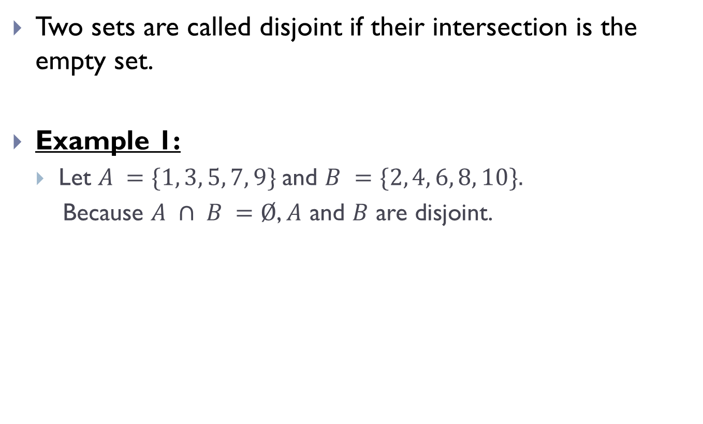
Disjoint Sets
Two sets are called disjoint if their intersection is the empty set.
Example 1:
Let $A =\{1, 3, 5, 7, 9\}$and $B =\{2, 4, 6, 8, 10\}.$
Because $A ∩ B =Ø$, $A$ and $B$ are disjoint.

Slide 9
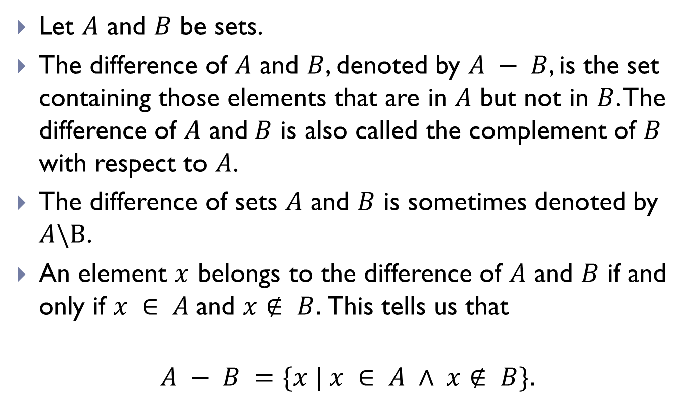
Difference of Sets
Let $A$ and $B$ be sets.
The difference of $A$ and $B$, denoted by $A − B$, is the set containing those elements that are in $A$ but not in $B$. The difference of $A$ and$B$ is also called the complement of $B$ with respect to $A$.
The difference of sets $A$ and $B$ is sometimes denoted by $A\backslash B$.
An element $x$ belongs to the difference of $A$ and $B$ if and only if $x ∈ A$and $x∉ B.$This tells us that
$$A − B =\{x | x ∈ A ∧ x∉ B\}.$$

Slide 10
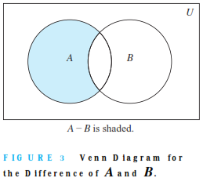
Difference of Sets(Contd.)

Slide 11
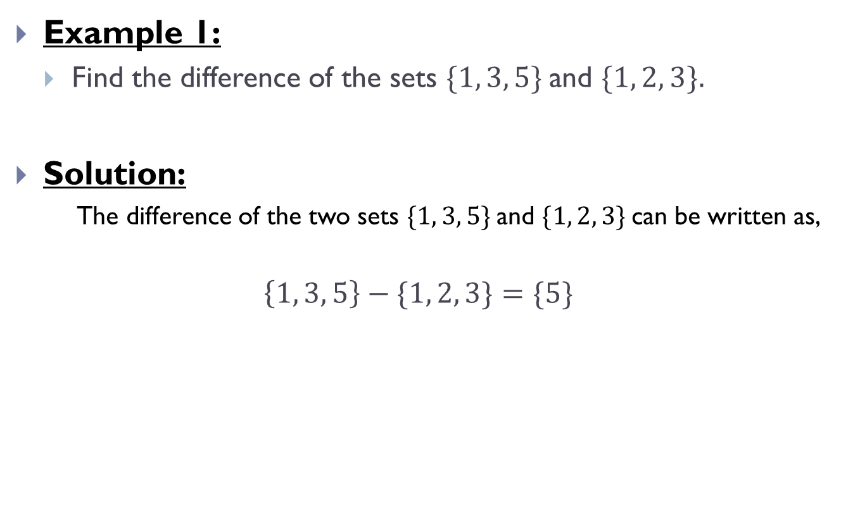
Difference of Sets(Contd.)
Example 1:
Find the difference of the sets $\{1, 3, 5\}$and $\{1, 2, 3\}.$
Solution:
The difference of the two sets $\{1, 3, 5\}$and $\{1, 2, 3\}$can be written as,
$$\left\{1, 3, 5\right\}−\{1, 2, 3\}=\{5\}$$

Slide 12
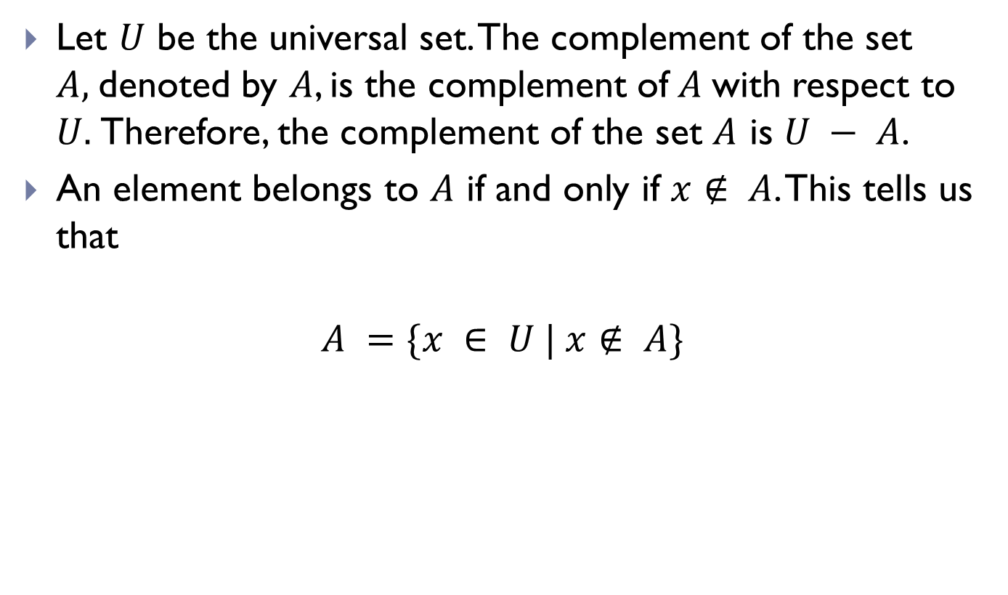
Complement of Sets
Let $U$ be the universal set. The complement of the set $A,$denoted by $A$, is the complement of$A$with respect to $U.$Therefore, the complement of the set $A$ is $U − A$.
An element belongs to $A$ if and only if $x∉ A$. This tells us that
$$A =\{x ∈ U | x∉ A\}$$

Slide 13
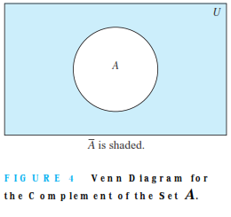
Complement of Sets(Contd.)

Slide 14

Complement of Sets(Contd.)
Example 1:
Let $A =\{a, e, i, o, u\}$(where the universal set is the set of letters of the English alphabet). Then
$$\overline{A} =\{b, c, d, f, g, h, j, k, l, m, n, p, q, r, s, t, v, w,x,y,z\}.$$

Slide 15
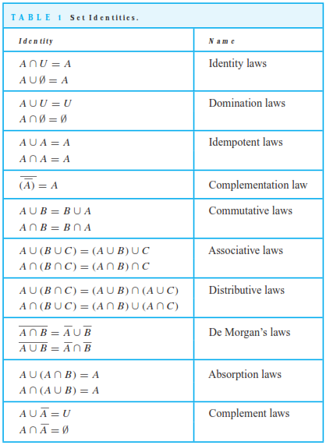
Set Identities

Slide 16
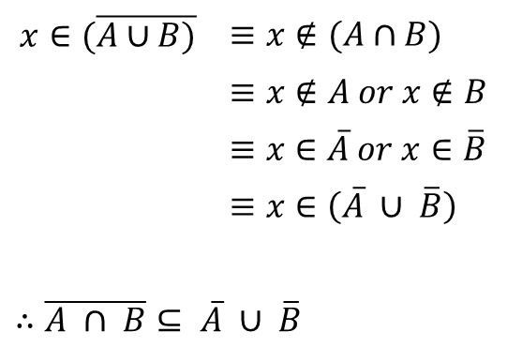


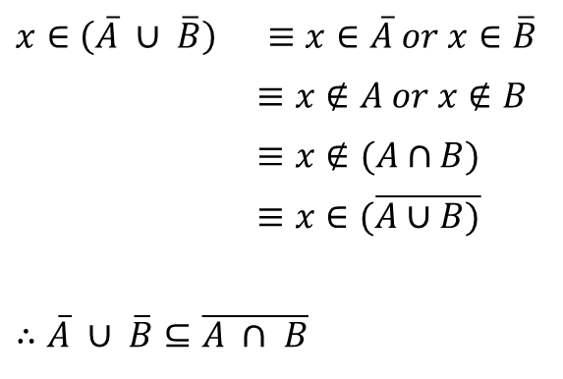
Set Identities(Contd.)
Example 1:
Prove that $\overline{A ∩ B}= \overline{A} ∪ \overline{B}$.
Solution:
Let,
Again Let,
$$x∈(\overline{A∪B)}$$ | $≡x∉(A∩B)$
 | $≡x∉A or x∉B$
 | $≡x∈\overline{A} or x∈\overline{B}$
 | $≡x∈\left(\overline{A} ∪ \overline{B}\right)$
$∴\overline{A ∩ B}⊆ \overline{A} ∪ \overline{B}$
$x∈\left(\overline{A} ∪ \overline{B}\right)$ | $$≡x∈\overline{A} or x∈\overline{B}$$
 | $≡x∉A or x∉B$
 | $≡x∉(A∩B)$
 | $≡x∈(\overline{A∪B)}$
$∴\overline{A} ∪ \overline{B}⊆\overline{A ∩ B}$
$$\overline{∴A ∩ B}= \overline{A} ∪ \overline{B}$$

Slide 17
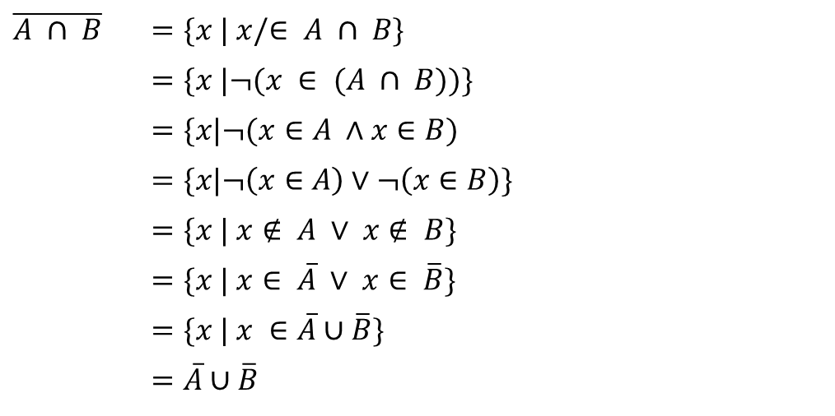

Set Identities(Contd.)
Example 2:
Use set builder notation and logical equivalences to establish the ﬁrst De Morgan law $A ∩ B =\overline{A}∪\overline{B}.$
Solution:
$\overline{A ∩ B}$ | $=\{x | x/∈ A ∩ B\}$
 | $=\{x |¬(x ∈ (A ∩ B))\}$
 | $=\{x|¬(x∈A ∧x∈B)$
 | $=\{x|¬\left(x∈A\right)∨¬\left(x∈B\right)\}$
 | $=\{x | x∉ A ∨ x∉ B\}$
 | $=\{x | x∈ \overline{A} ∨ x∈ \overline{B}\}$
 | $=\{x | x ∈\overline{A}∪\overline{B}\}$
 | $=\overline{A}∪\overline{B}$

Slide 18
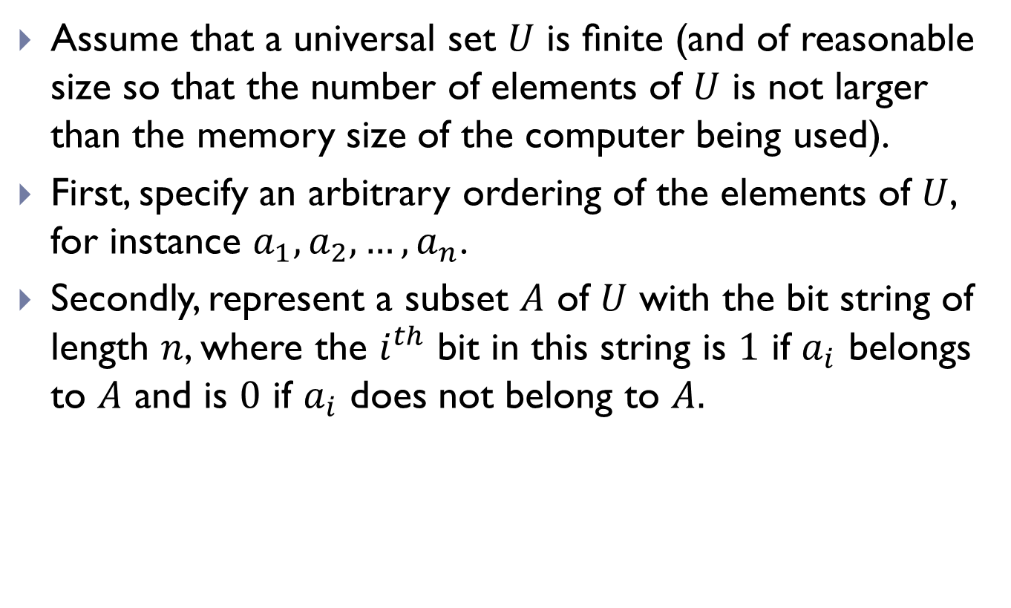
Computer Representation of Sets
Assume that a universal set $U$ is ﬁnite (and of reasonable size so that the number of elements of $U$ is not larger than the memory size of the computer being used).
First, specify an arbitrary ordering of the elements of $U$, for instance $a_{1},a_{2},…,a_{n}$.
Secondly, represent a subset $A$ of $U$ with the bit string of length $n$, where the $i^{th}$ bit in this string is $1$ if $a_{i}$ belongs to $A$ and is $0$ if $a_{i}$ does not belong to $A.$

Slide 19
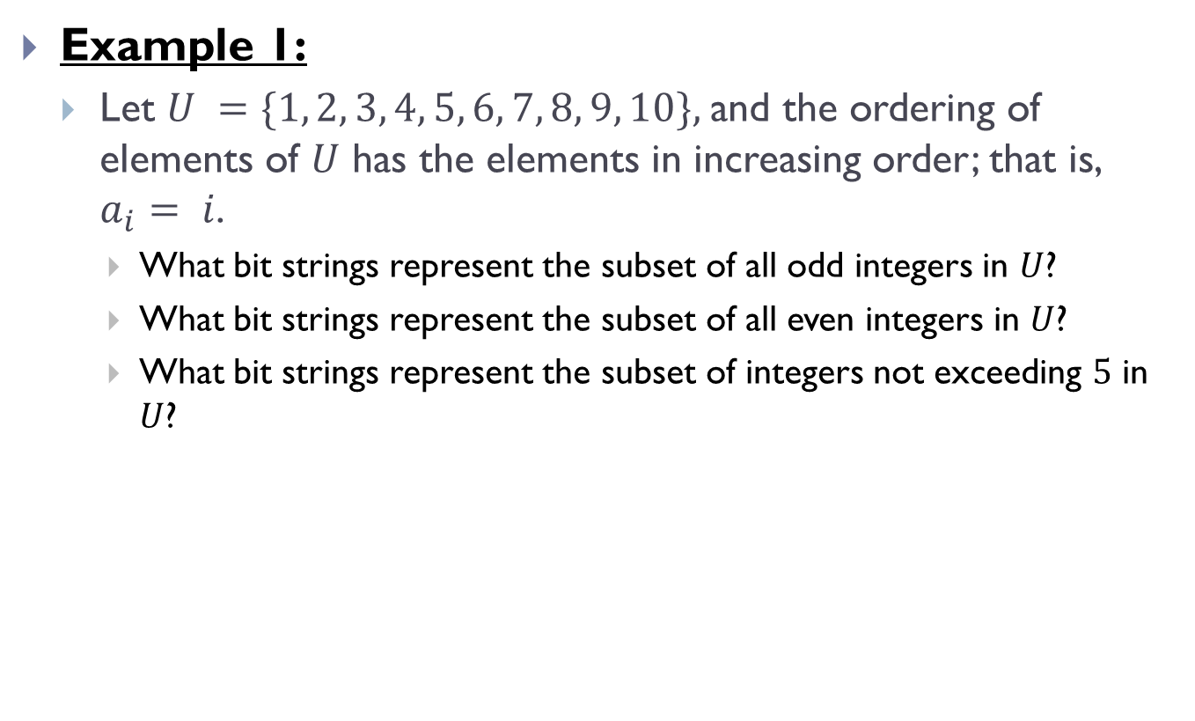
Computer Representation of Sets(Contd.)
Example 1:
Let $U =\{1, 2, 3, 4, 5, 6, 7, 8, 9, 10\},$and the ordering of elements of $U$ has the elements in increasing order; that is, $a_{i}= i$.
What bit strings represent the subset of all odd integers in $U$?
What bit strings represent the subset of all even integers in $U$?
What bit strings represent the subset of integers not exceeding $5$ in $U$?

Slide 20
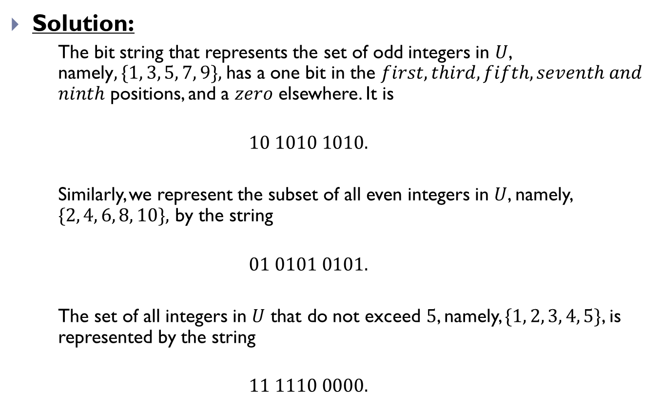
Computer Representation of Sets(Contd.)
Solution:
The bit string that represents the set of odd integers in $U$, namely$, \{1, 3, 5, 7, 9\},$ has a one bit in the $first, third, fifth, seventh and$ $ninth$ positions, and a $zero$ elsewhere. It is
$$10 1010 1010.$$
Similarly, we represent the subset of all even integers in $U$, namely, $\{2, 4, 6, 8, 10\},$ by the string
$$01 0101 0101.$$
The set of all integers in $U$ that do not exceed $5$, namely, $\{1, 2, 3, 4, 5\}$, is represented by the string
$$11 1110 0000.$$

Slide 21

Computer Representation of Sets(Contd.)
Example 2:
Let $U =\{1, 2, 3, 4, 5, 6, 7, 8, 9, 10\},$and the ordering of elements of $U$ has the elements in increasing order; that is, $a_{i}= i$.
What bit strings represent the complement of the subset of all odd integers in $U$?

Slide 22
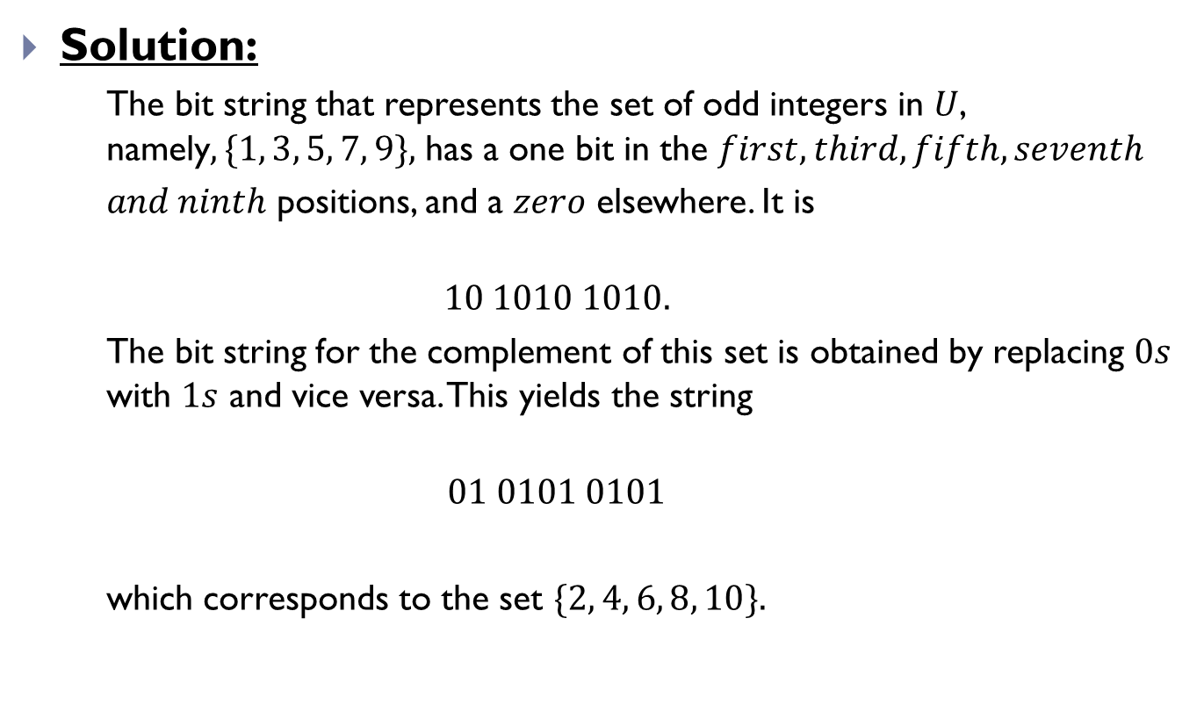
Computer Representation of Sets(Contd.)
Solution:
The bit string that represents the set of odd integers in $U$, namely$, \{1, 3, 5, 7, 9\},$ has a one bit in the $first, third, fifth, seventh$
$and ninth$ positions, and a $zero$ elsewhere. It is
$$10 1010 1010.$$
The bit string for the complement of this set is obtained by replacing $0s$ with $1s$ and vice versa. This yields the string
$$01 0101 0101$$
which corresponds to the set $\{2, 4, 6, 8, 10\}.$

Slide 23
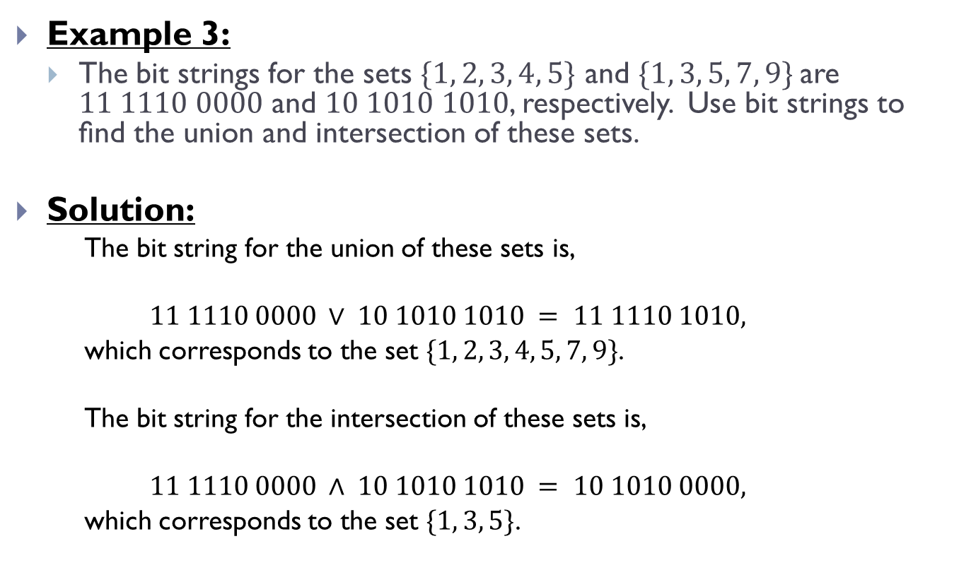
Computer Representation of Sets(Contd.)
Example 3:
The bit strings for the sets $\{1, 2, 3, 4, 5\}$ and $\{1, 3, 5, 7, 9\}$are $11 1110 0000$ and $10 1010 1010$, respectively. Use bit strings to ﬁnd the union and intersection of these sets.
Solution:
The bit string for the union of these sets is,
$$11 1110 0000 ∨ 10 1010 1010 = 11 1110 1010,$$
which corresponds to the set $\{1, 2, 3, 4, 5, 7, 9\}$.
The bit string for the intersection of these sets is,
$$11 1110 0000 ∧ 10 1010 1010 = 10 1010 0000,$$
which corresponds to the set $\{1, 3, 5\}$.

Slide 24
THE END

